Slide 1
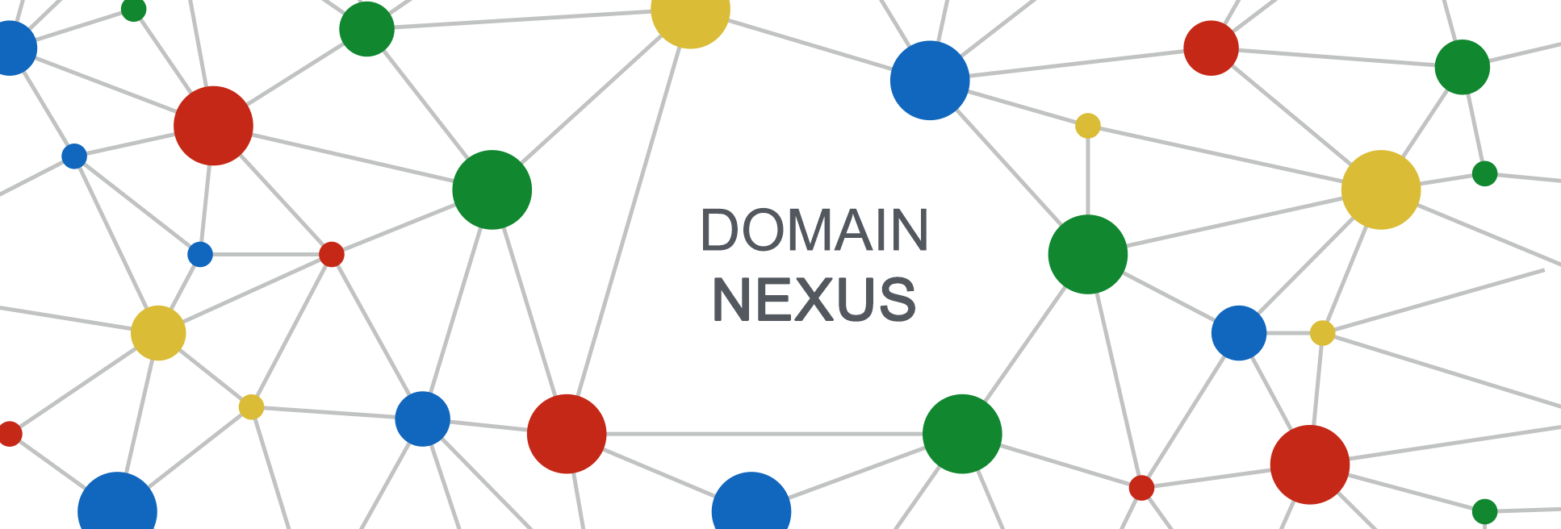
Domain NEXUS
Data Processing & Latest Results
Cyrano Chen, SMB Innovation Lab, SAP
May 10, 2018

Slide 2
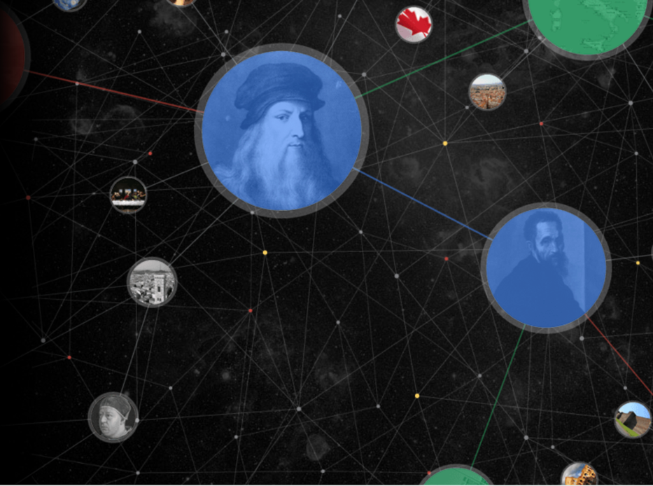
Agenda
Data Collection & Preprocessing
Search Topic
Collect Posts Content
Extract People Entities
Data Analysis Visualization
People
Individual Types
Individual Contribution
Individual Character
Word Cloud

Slide 3
I. Data Collection & Preprocessing jam4.sapjam.com
Cyrano Chen, SMB Innovation Lab, SAP
Partner logo

Slide 4


1. Search Topic search certain topic by using keyword on jam
keyword: Chatbot
total result: 2798
include: wiki, profile, groups, discussions, ideas, feed, questions, blogs, poll, tasks
documents: 97.8%
keyword: Blockchain
total result: 15127
include: wiki, groups, discussions, ideas, feed, questions, blogs, poll, articles, tasks
documents: 94.9%

Slide 5
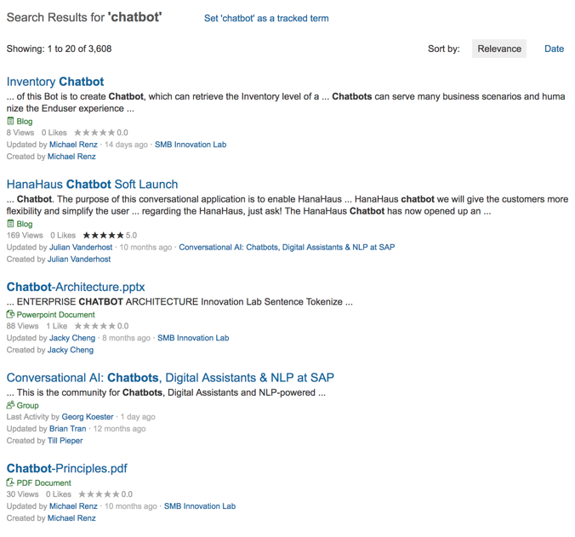
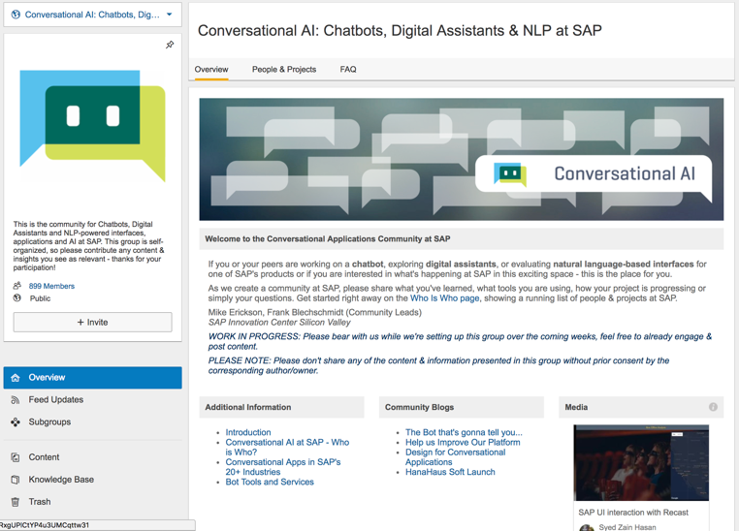
2. Collect Content of Posts (optional) develop spiders for crawling html content from posts
Crawl content if no access to api
search result pages
total content of posts or group overview
people profiles, organization and social graph
scrapy, splash (python3)
It costs several hours to download the total content of posts
(spent 12 hours on getting total 2G data of topic blockchain)

Slide 6
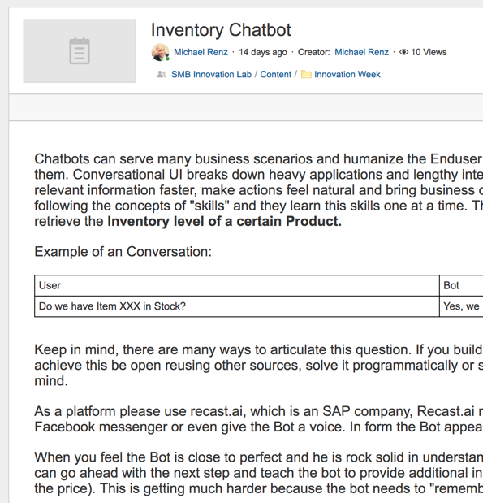
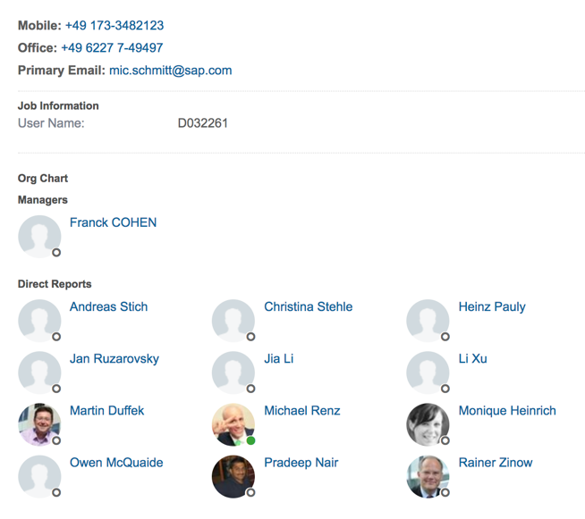
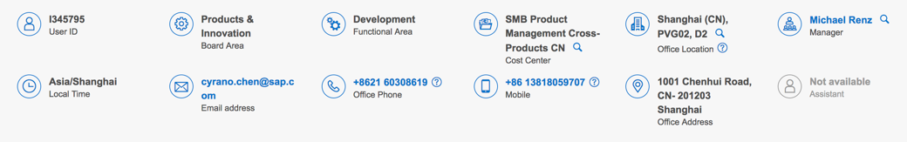
3. Extract entities of People call openapi of jam will be better
keyword: Chatbot
collect from post page
collect from profile
collect from people@sap
process the free data to structured
profiles
organization
social graph
roles of posts
regions
It costs several minutes on analyzing html and extracting entitles from html

Slide 7

II. Data Analysis Visualization jupyter, ECharts, D3js
Cyrano Chen, Innovation Lab, SAP

Slide 8

2.1 People
Chatbot:
People Entities Extraction: 6323
Perform as Creator: 1088
Perform as Participator: 459
Group Entities Extraction: 28
Blockchain:
People Entities Extraction: 33338
Perform as Creator: 3428
Perform as Participator: 1527
Group Entities Extraction: 165
All entities have been structured and persisted into local DB
jupyterlab of anaconda (python3)

Slide 9
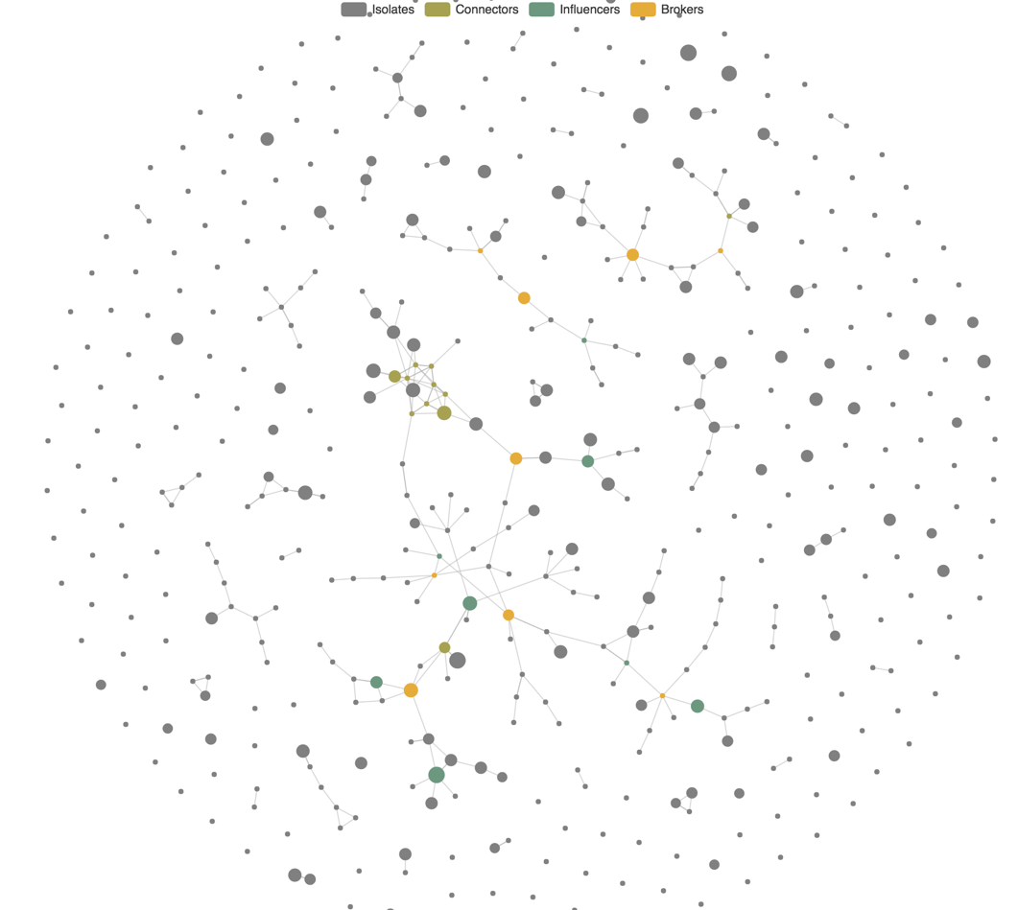
2.1 People - Individual Types
Generate Dataset for Visualization
configuration
TOPIC_KEYWORD = 'ChatBot'
POSTS_THRESHOLD = 2
LINKS_THRESHOLD = 21
links.json (output)
managers, reports
followers, following
comments, likes
nodes.json (output)
base on Network-type theory
Isolates (low degree)
Connectors (high degree)
Influencers (high closeness)
Brokers (high betweeness)
NetworkX 2.1 (python3)
ECharts 4.1 (javascript)

Slide 10
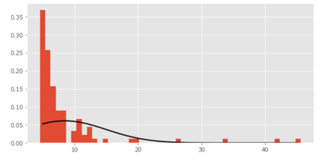
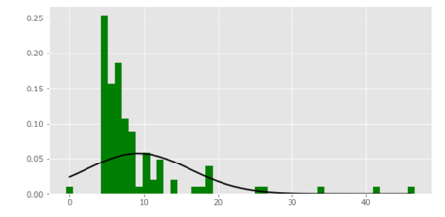
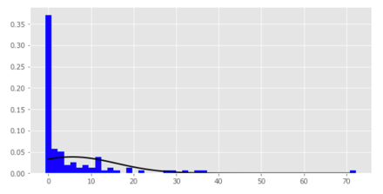
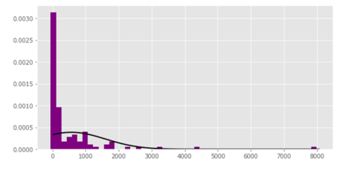
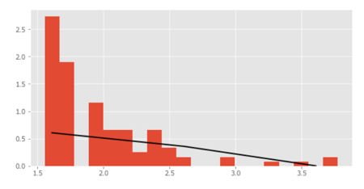
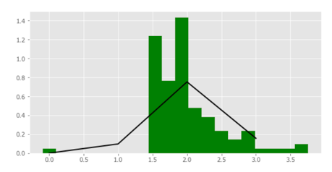
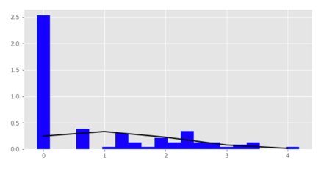
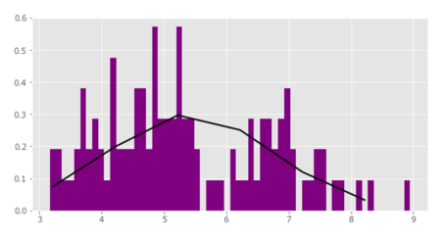
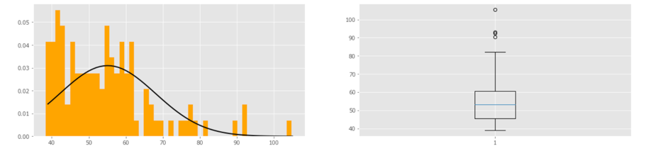
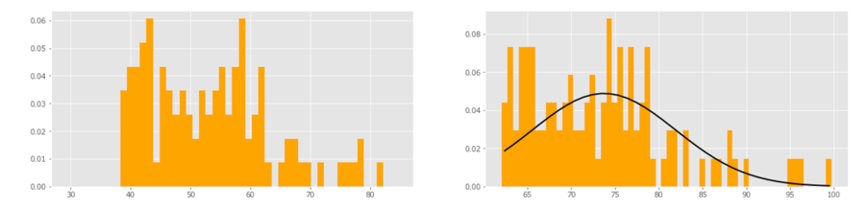
2.1 People - Individual Contribution
Posts
Comments
Likes
Views
log(x)
weights = {'posts': 12.0, 'comments': 8.0, 'likes': 4.0, 'views': 2.0}
threshold: 83.64 75.46, length 2σ: 11 of 109, length 3σ: 41 of 109, final score: from 75.85 to 100

Slide 11
2.3 People - Individual Character Recognition
Type / Contribution | Low | Posts > 2 | Higher(3σ)
Isolates | Thinkers 356 | Pioneers 92 | Pioneers 33
Connectors | Delegators 8 | Generators 3 | Generators 2
Influencers | Enablers 3 | Teamsters 5 | Teamsters 5
Brokers | Broadcasters 4 | Definers 5 | Definers 2

Slide 12
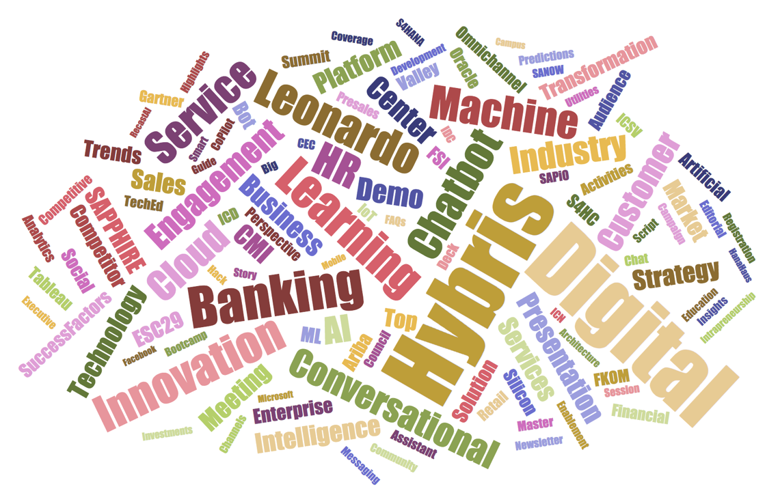
2.2 Knowledge – Word Cloud
Generate Dataset from Posts
data source
title of post
description on search result (abstract)
tags (important if exist)
preprocess
managers, reports
followers, following
comments, likes
visualize
font size depend on frequent of word
set number of word: 250 – 300
Archimedean Spiral
sqrt(n) transform on frequent
10 orientations from -60° to 60°
D3js (svg, javascript)

Slide 13
Thank you.
Cyrano Chen
SENIOR DATA SCIENTIST
PVG02 D2.30
13818059707
Partner logo

